Slide 1


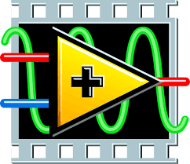
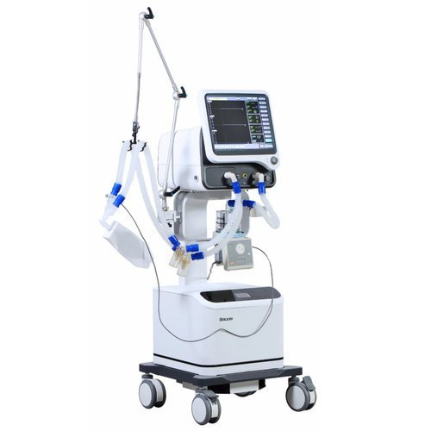
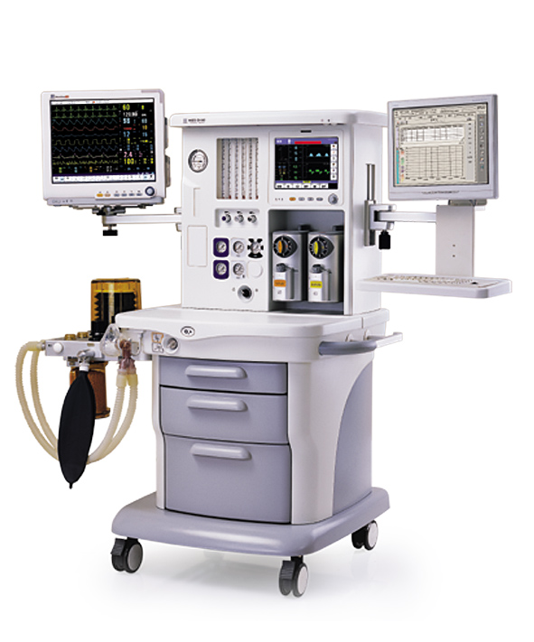
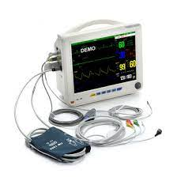
Dhirajlal Gandhi College of Technology, Salem.
“ AUTOMACY BOYLE’S MACHINE CONTROL USING
MY OPEN LAB & PYTHON”
S.SRIDHAR 611618121045
K.DILEEP 611618121010
S.SYED MOHAMED 611618121046
S.SATHISH 611618121040
Under the guidance of
M. Hema Kumar M.E., M.B.A., (Ph.D)
Assistant Professor
Department of Biomedical Engineering
Notes:
For more information visit: http://abacus.bates.edu/~ganderso/biology/resources/writing/HTWsections.html#introduction

Slide 2



WHAT IS WHAT?
OBJECTIVE
ABSTRACT
PROBLEM DESCRIPTION
LITERATURE SURVEY
PROPOSED WORK
SECTION DESCRIPTION
BLOCK DIAGRAM
RESULTS
ANESTHETIC GASES
MY OPEN LAB WORKING
JET INJECTOR
WORKING
TEAM MEMBERS ROLES AND RESPONSIBILITIES
WORK CHART
CONFERENCE PARTICIPATION
CERTIFICATES
FUTURE APPLICATIONS
ANY QUARIES

Slide 3
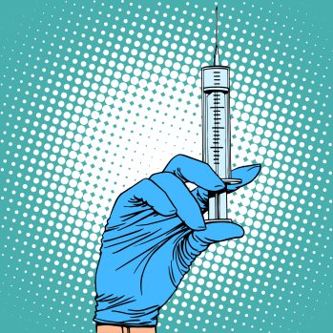
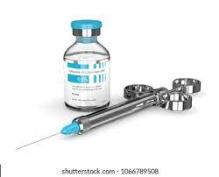
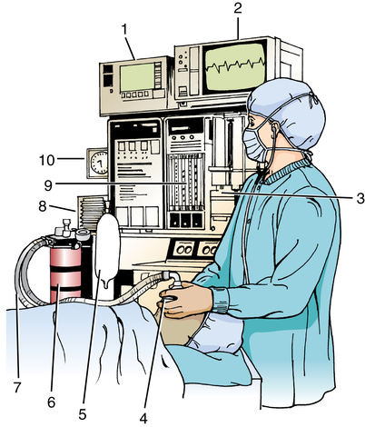

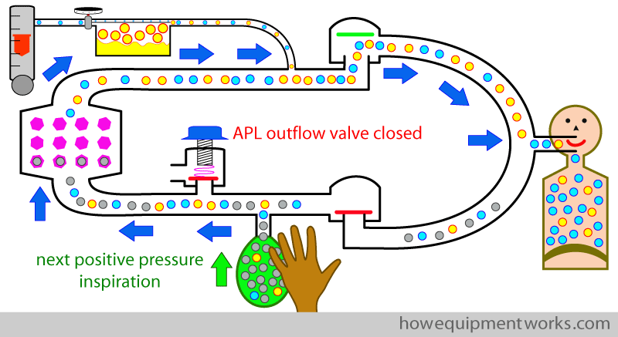
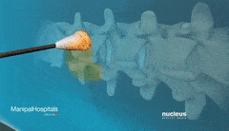
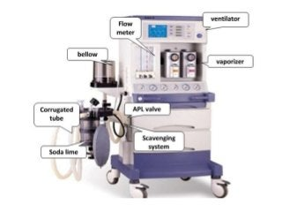
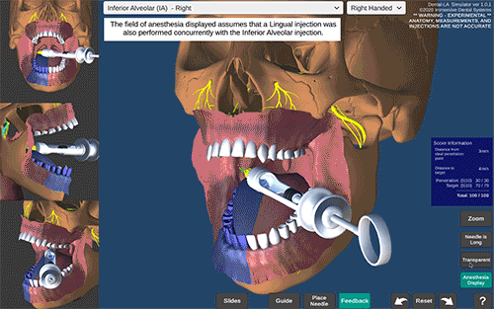

WHAT IS WHAT?

Slide 4
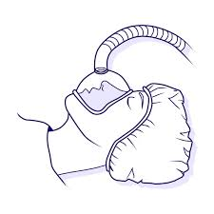

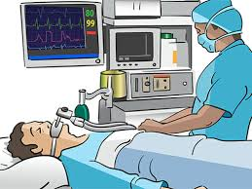


OBJECTIVE
The main objective of our proposed design is to avoid lethal effect,negative impact & post operative complication of the patient by managing the high or low dose of anesthesia drug during surgery with the help of My-Open-lab,simultaneously checking the biomedical paramaters to aviod hypo/hypertension and other medical complications.The new design uses advanced electronics, software and technology to offer extensive capabilities for ventilation, monitoring and inhaled agent delivery.
1.My-Open-Lab administering anesthesia during General anesthesia.
2.Jet injector administering anesthesia during local anesthesia detecting vein
proceed to administering.
Notes:
Its purpose is to clearly state the research problem and give the reader a motivation, justification about the case. The introduction should answer the question What was studied and state partially the goal?
Sometimes it is combined with the literature review to set the methodological and practical gaps found in the state-of-the-art body.

Slide 5
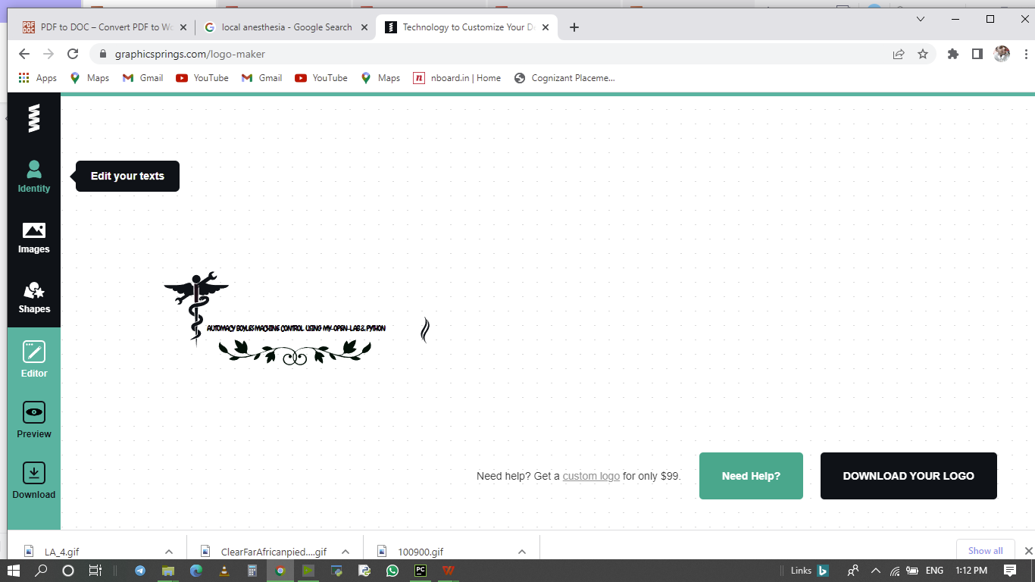
ABSTRACT
Now a days delivering an precise amount of anesthesia to the patient plays a pivotal role in each and every major surgeries.Failing in providing an exact level of dosage to the patient may leads to negative impact and postoperative complications.Administering less dose of the anesthesia to the patient it leads to consciousness and pain sensation during the operation,high dosage of anesthesia leads to the patient become coma, stupor,paralysis, paresthesia ,Migraine.The blood pressure sensor is attached with this device to identify the patient whether they are in hypotension /hypertension to rescue the patient from cardiac hypertrophy during surgery.To resolve this kind of problems during surgeries a computer -controlled My-Open-lab is designed to deliver an accurate dose of anesthesia at regular intervals of time with constant speed for general anesthesia and local anesthesia..For that reason this project aims to introduce an”AUTOMACY BOYLE’S MACHINE CONTROL”.My open lab make use of jet injector to deliver the precise amount of anesthesia to the patient with the help of switch control panel during local anesthesia without needles to providing 100% pain free surgery.
Notes:
Its purpose is to clearly state the research problem and give the reader a motivation, justification about the case. The introduction should answer the question What was studied and state partially the goal?
Sometimes it is combined with the literature review to set the methodological and practical gaps found in the state-of-the-art body.

Slide 6
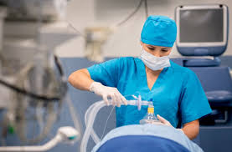
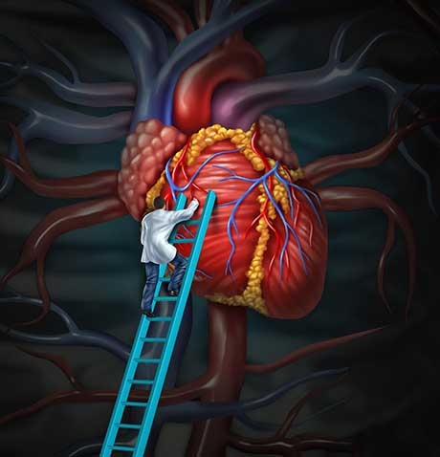
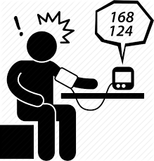
PROBLEM DESCRIPTION
The Major surgeries could take upto 4 to 5 hours. In this, the complete dosage of anesthesia couldn’t be administered in single dosage to patients.
Excess dosage may cause critical condition to patient which could lead to permanent unconsciousness.
Failing in continous monitoring of biomedical paramters leads to hypo/hypertension,cardiac hypertrophy and medical complications during surgery.
In local anesthesia if you proceed to inject without being properly positioned in a vein, you'll be putting your drugs into the tissue surrounding the vein, under the skin, or some other place. It will probably be painful and become swollen, and the effects of your drugs will come on much more slowly.
Notes:
Its purpose is to clearly state the research problem and give the reader a motivation, justification about the case. The introduction should answer the question What was studied and state partially the goal?
Sometimes it is combined with the literature review to set the methodological and practical gaps found in the state-of-the-art body.

Slide 7
LITERATURE SURVEY
S.NO | TITLE | AUTHOR | YEAR | JOURNAL | WORK DONE
1. | Advances in medicine engineering crossover in automated anesthesia. | Tianyi xu,Ming xia,Hing jiang | 2021 | Journal of shanghai jiatong university(science) | Development of robots in anesthesia,monitoring alarm technology.
2. | Artifical intelligence and anesthesia. | Madhavi singh,Gita nath | 2021 | Saudi journal of anesthesia | It high lighting the artificial intelligence and machine learning in anesthesia system.
3. | Automated anesthesia balancer device using advanced technology | Ananya H P,Arpitha R,Brunda H M,Naveenkumar N,Dhanalakshmi R. | 2021 | ISSN | Programmed anesthesia regularization.
4. | Automatic anesthesia control system | chandana R,Kaveen V,Gajalakhmi M,Dr,Joshi manisha S | 2021 | INJEAST | Measurement of heart rate & body temperature
5. | Automatic anesthesia control system | ShelishiyahRaymond,SusmithaEdagottu,Lasngewhun Mawblei, Minhajul Ahmed | 2021 | ICBSII | Using Bio-signals,image and Instrumentation
Notes:
Its purpose is to clearly state the research problem and give the reader a motivation, justification about the case. The introduction should answer the question What was studied and state partially the goal?
Sometimes it is combined with the literature review to set the methodological and practical gaps found in the state-of-the-art body.

Slide 8
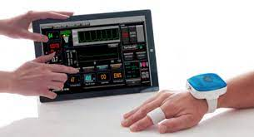

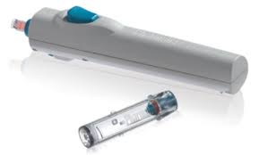
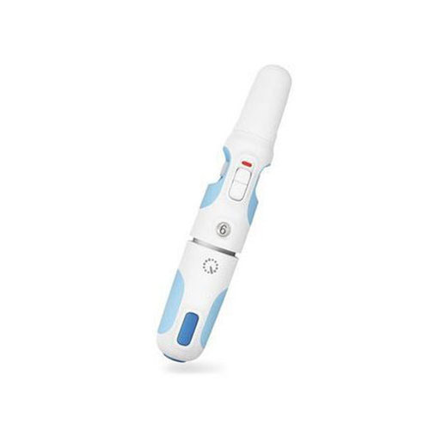
PROPOSED WORK
This project consisting of mainly five sections;
General anesthesia:
1. checking biomedical parameters of the patient.
2. Patient input and MAC value by using python.
3. Automated drug delivering system &jet-injector by using my-open lab.
4.Sending notification to the doctor while the patient in abnormal condition.
Local anesthesia:
5.Nerve stimulation and administering anesthesia by using Jet-Injector
Notes:
Its purpose is to clearly state the research problem and give the reader a motivation, justification about the case. The introduction should answer the question What was studied and state partially the goal?
Sometimes it is combined with the literature review to set the methodological and practical gaps found in the state-of-the-art body.

Slide 9

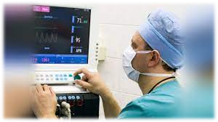
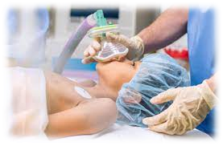
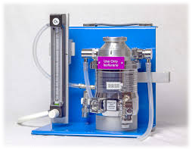
SECTION DESCRIPTION
USING PYTHON PROGRAMMING;
python programming is helps to monitoring the blood pressure of the patient by using patient monitoring system.whether the patient blood pressure 120/80 means only the the operation proceeds and sends the notification,if it fails means it wait for the normal blood pressure then it proceeds it work and it will alert when it starts to work.
GETTING INPUT FROM USER;
Age,Weight,Mac values are set by manually,and it proceeds to work by using
python.
PROVIDING ANESTHESIA;
If any variation in dosage diluted then the drug or oxygen/nitrogen level is adjusted accordingly.Jet injector will provide the anesthesia as per the MAC value.

Slide 10
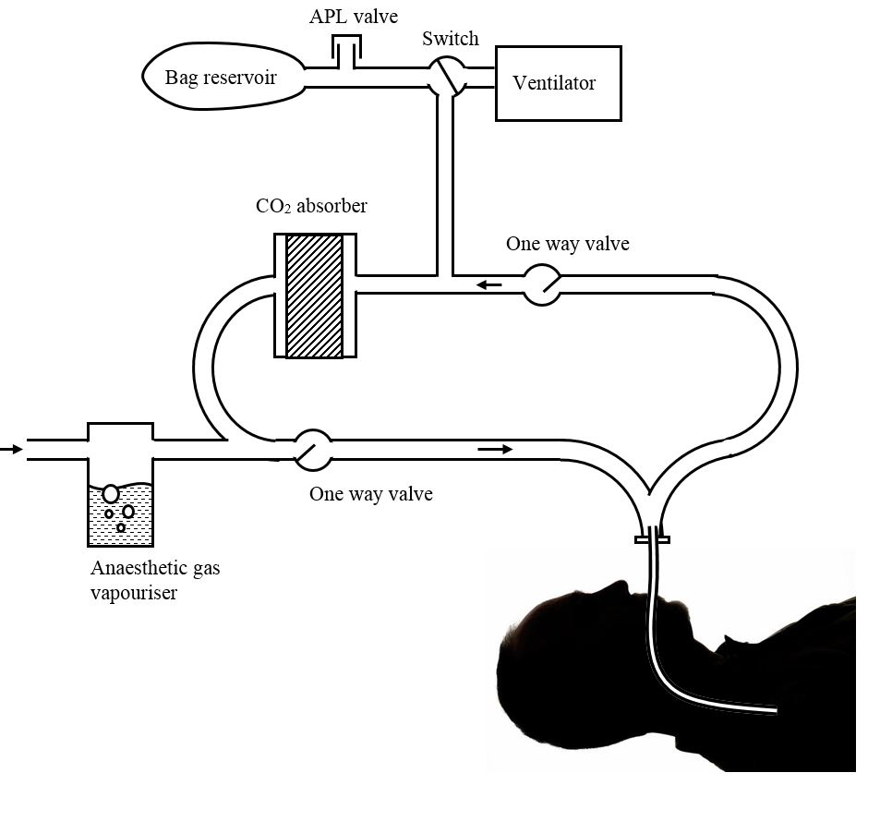
BLOCK DIAGRAM
GENERAL ANESTHESIA
MULTIPARAMONITOR
MY-OPEN-LAB STARTED WORKING
GETTING INPUT
1.SPO2
2.HB
3.BP
4.ECG AND BT
SETTING INTUBATION TIME
INPUT
AGE,WEIGHT, HEIGHT USING PYTHON
Control 5 Anesthetic agents,
N20 & 02
SURGERY TYPE
MAC VALUE
(0 to 2)
CHECKING VITALS
CALCULATING BMI
Notes:
Its purpose is to clearly state the research problem and give the reader a motivation, justification about the case. The introduction should answer the question What was studied and state partially the goal?
Sometimes it is combined with the literature review to set the methodological and practical gaps found in the state-of-the-art body.

Slide 11
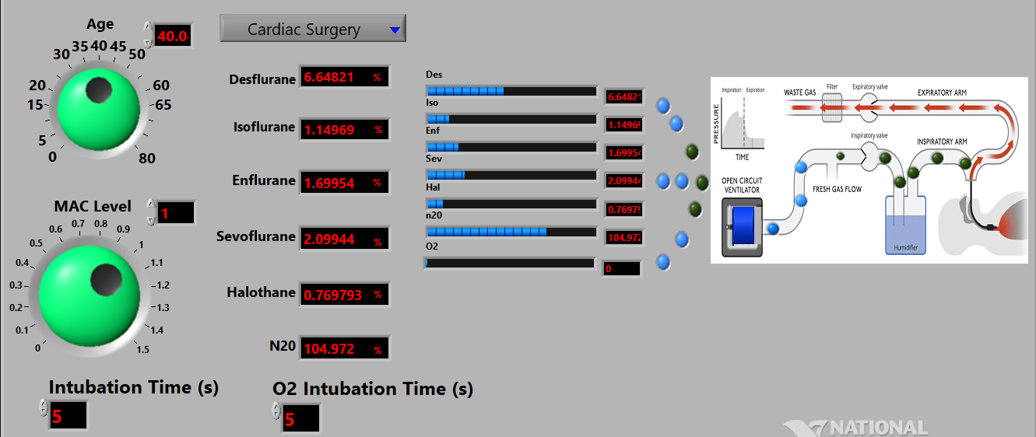
RESULTS
FRONT PANEL
Notes:
Its purpose is to clearly state the research problem and give the reader a motivation, justification about the case. The introduction should answer the question What was studied and state partially the goal?
Sometimes it is combined with the literature review to set the methodological and practical gaps found in the state-of-the-art body.

Slide 12
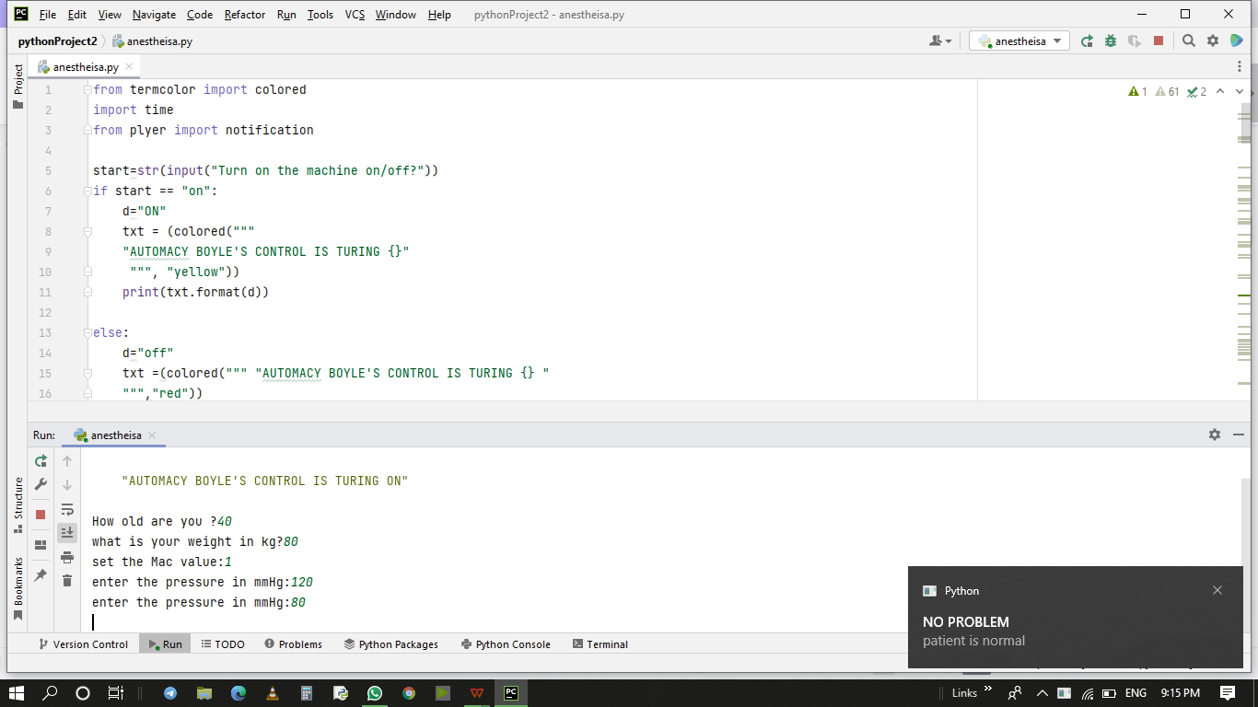

CHECKING THE BLOOD PRESSURE USING PYTHON

Slide 13
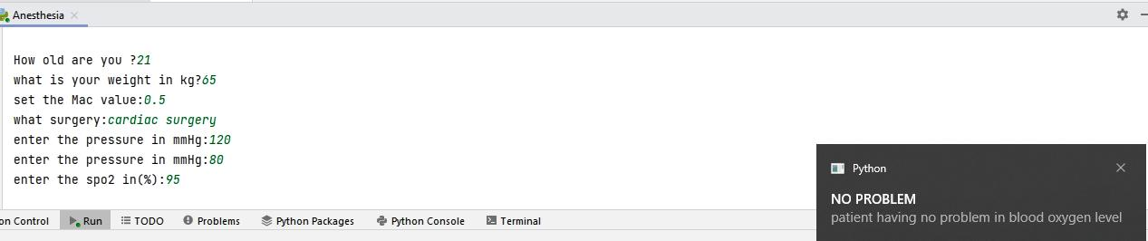
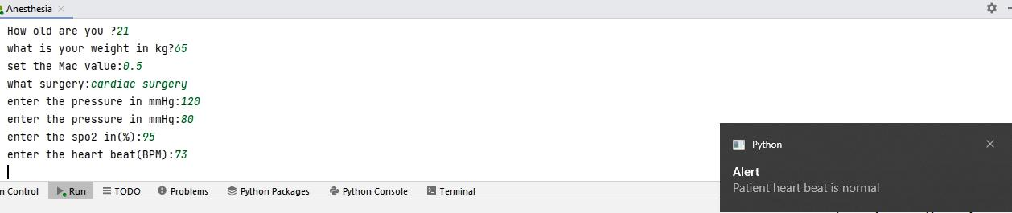
CHECKING SPO2 USING PYTHON
CHECKING HEART-BEAT USING PYTHON

Slide 14
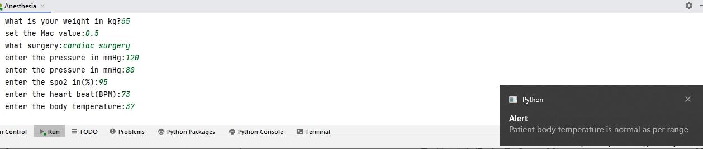
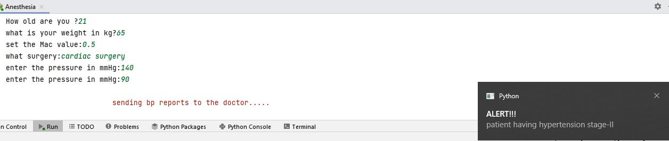
CHECKING BODY-TEMPERATURE USING PYTHON
FINDING ABNORMALITY AND LEAVES NOTIFICATION TO DOCTOR:

Slide 15
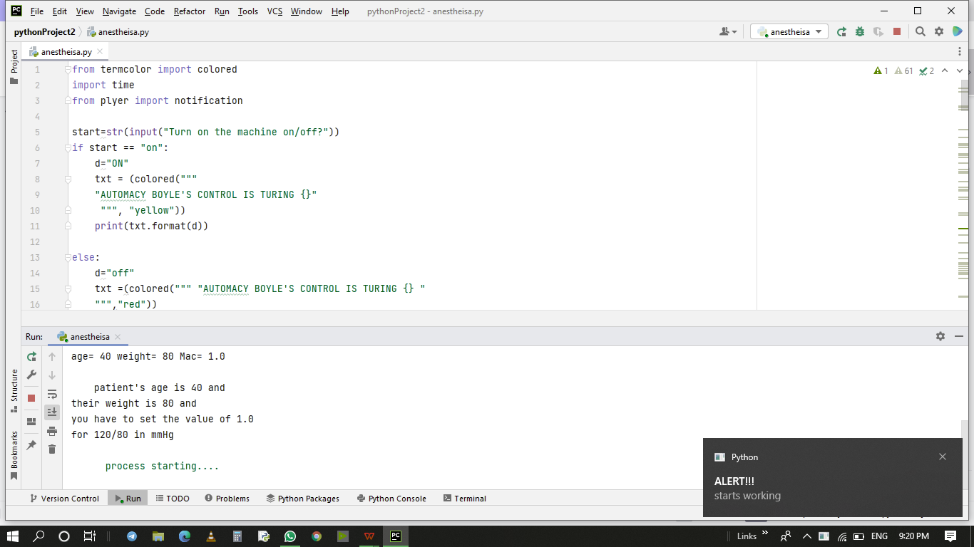
NOTIFICATION WHILE STARTING THE PROCESS

Slide 16
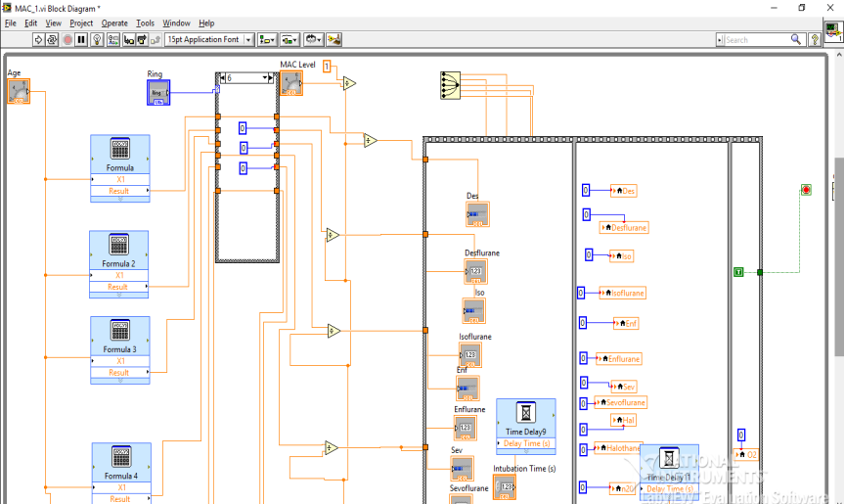
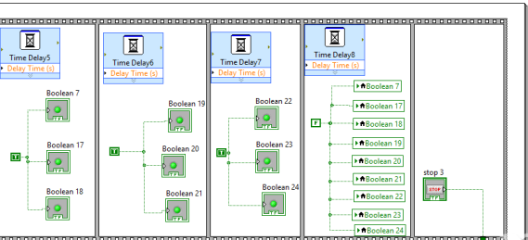
BLOCK DIAGRAM PANEL

Slide 17
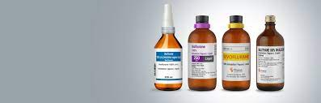
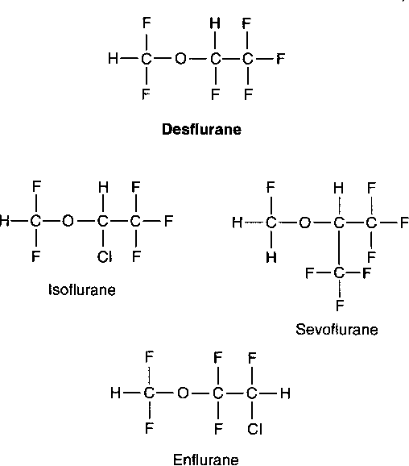
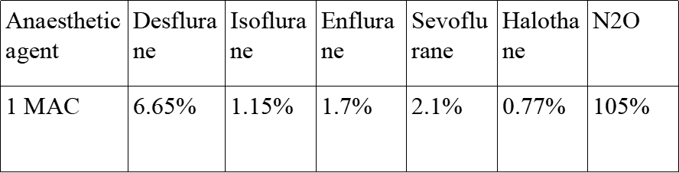
ANAESTHETIC AGENTS:
N2O
Desflurane
Isoflurane
Enflurane
Sevoflurane
Halothane
MAC age = MAC 40 * 10 ^ (-0.00269*(age-40))

Slide 18
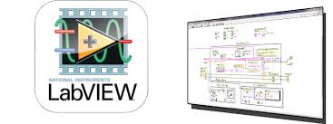
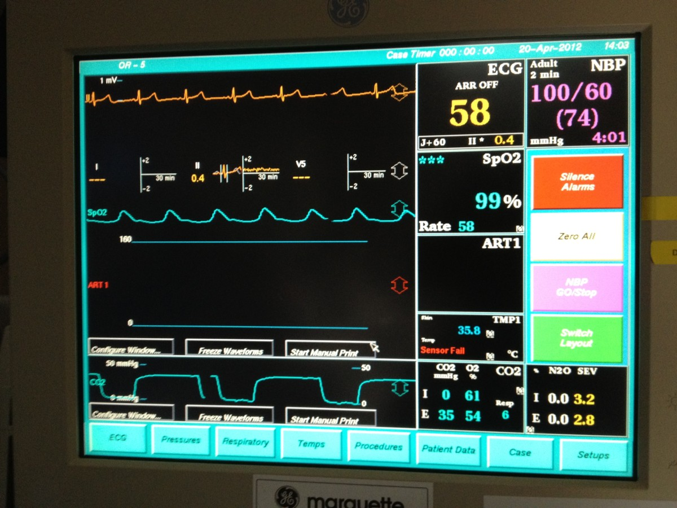
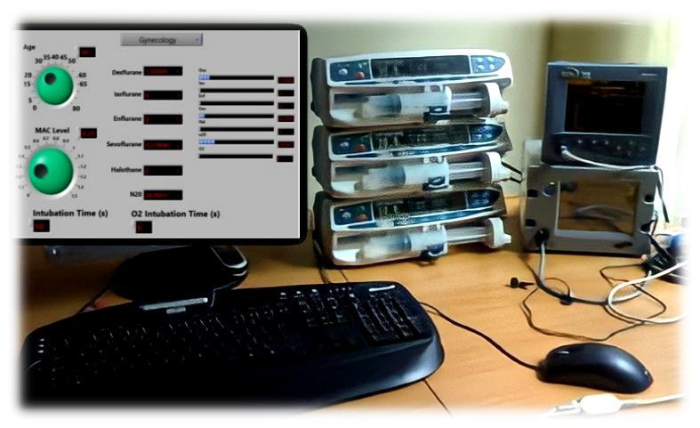
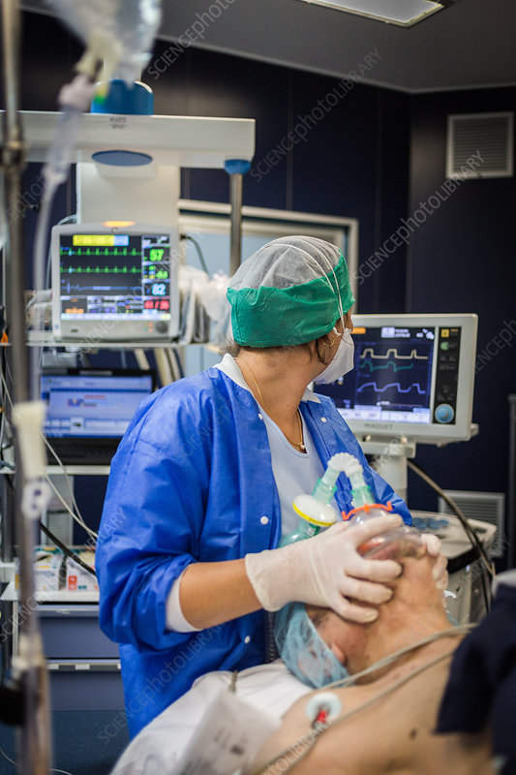
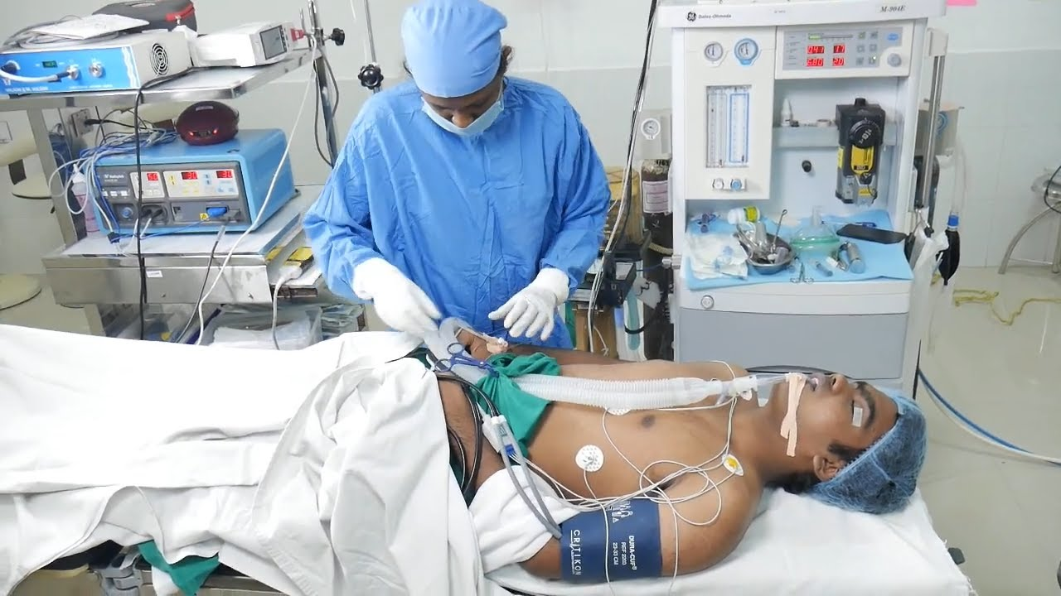

MY-OPEN-LAB WORKING
The inputs age and weight and then blood pressureHear-Beat,Spo2,Bodytemperature associated with MAC value with the 5 anaesthetic agents required for the type of surgery is selected by the anaesthetic doctor.
Automatically the machine starts providing anaesthesia with the help of My-Open-Lab.
The intubation time and recovery O2 time also provided by the doctor at the time of selection.
This procedure runs until the time specified by the Doctor.

Slide 19
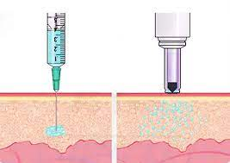
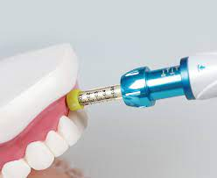
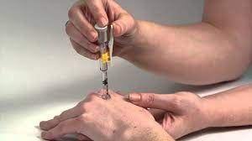
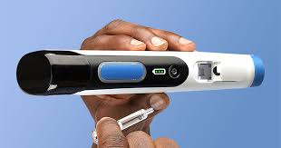
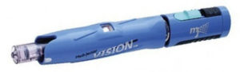
JET INJECTOR
A jet injector is a medical device used for providing drug to the patient that uses a high-pressure, narrow stream of fluid to penetrate the skin instead of a needle. Jet injectors may be powered by compressed gas or springs.
Jet injectors are needle-free devices that push the liquid medication through a nozzle orifice.
The medication is ejected through the nozzle as a narrow stream under high pressure.
This medication stream penetrates the skin to deliver a drug or vaccine into intradermal, subcutaneous, or intramuscular tissues

Slide 20

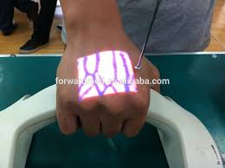

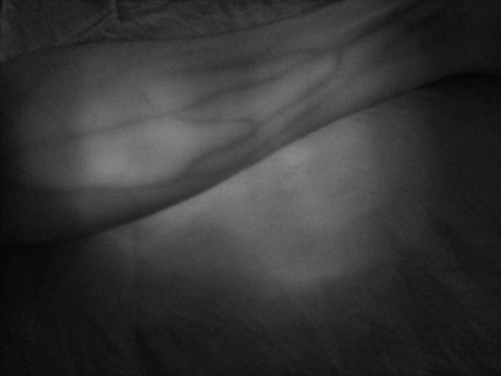
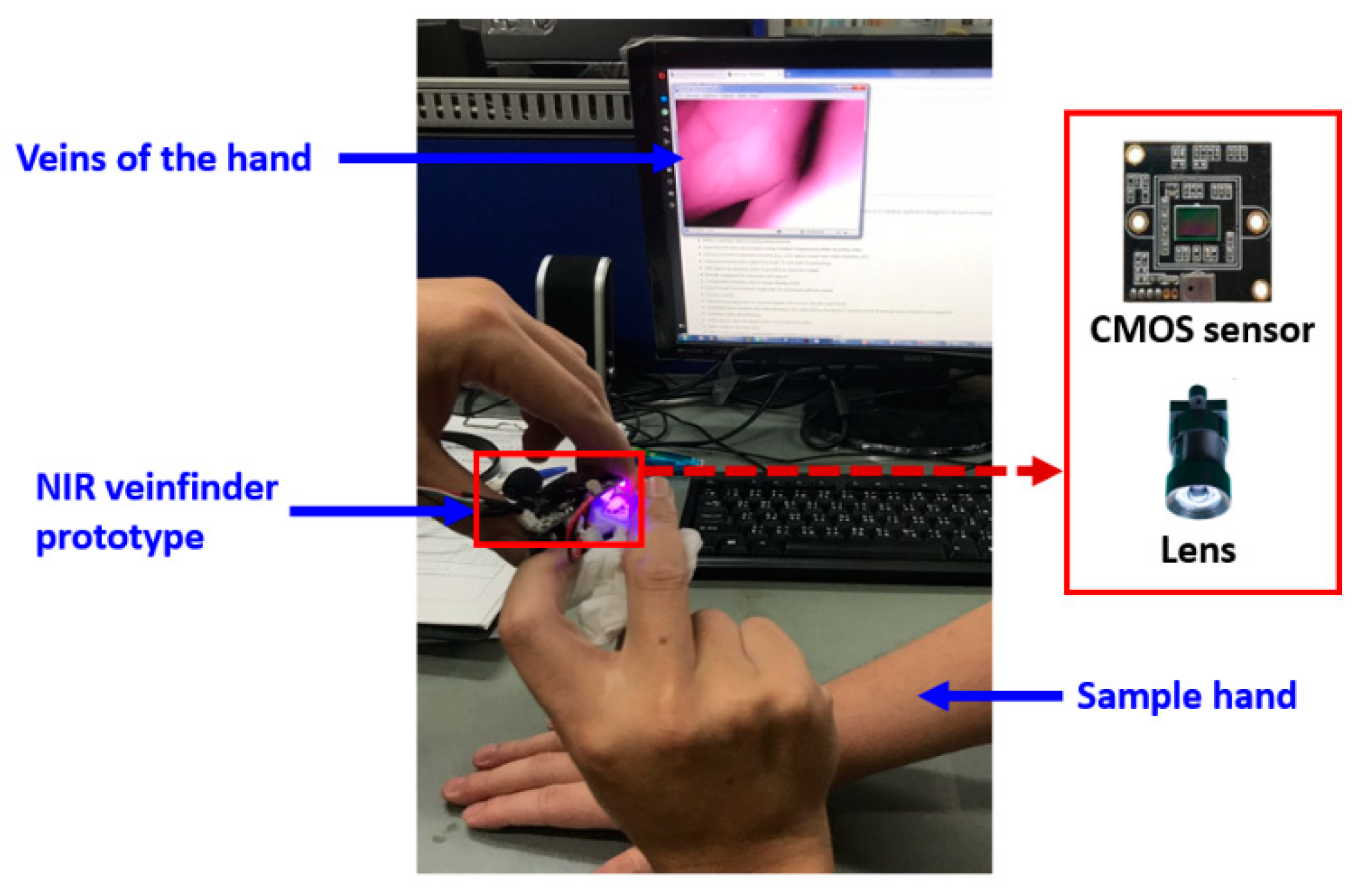
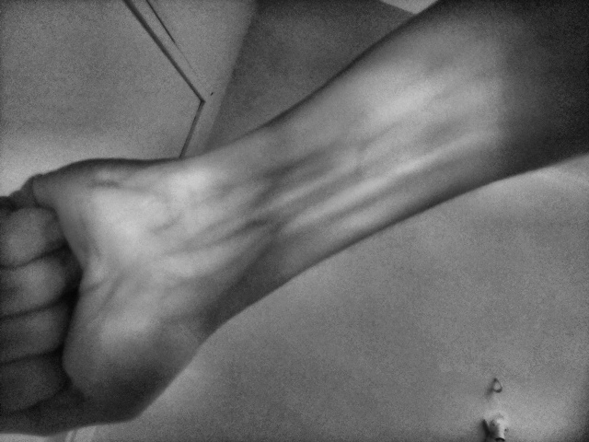

VEIN-DETECTION USING PYTHON&IR CAMERA
Use Near Field Infrared Light to take an image of the veins
• Process this image to obtain the skeleton of veins
• Identify veins by contouring
• Draw the veins on a live feed to provide augmented reality style
solution
• Vein detection is used to administering local anesthesia to the exact location
• It placed at the right top corner of the Jet-Injector

Slide 21






WORKING
It involves numbing an area of the body using a anesthetic medicine
IR-camera is placed at the top of the jet-injector it helps to identify the vein to administering the anesthesia to the patient.
it is needle free injector it will spread the medicine to all over the intramuscular region as fast.

Slide 22
TEAM MEMBERS ROLES AND RESPONSIBILITIES
TEAM MEMBERS NAME | ROLES | RESPONSIBILITIES
S.SRIDHAR | Proposed Design and software development | Establishing the idea and planned to excecute the concept of this project and advising team mates to do some benefecial activities to develop the project content.working on software development of proposed design.
S.SYED MOHAMMED | Proto-type-Model,Execution , Enhancement | Ensuring efficient execution of the algorithm and creating modules and features in proposed design.creating libraries for prominant result execution.
S.SATHISH | Paper Work for Conference&collecting sample from the patients | prepared documentsand report for our proposed work and collecting data.collecting the samples from the hospitals for reference purpose.
K.DILEEP | Report Work | fixing mistakes and edit the content and preparing for subsequent reviews

Slide 23
WORK- CHART
Month / Date Activity | Area Selection | Review 0 FEB |  | Review I MARCH |  | Review II (Final) MARCH |  | Demo/Report APRIL
 | NoV- DEC | 05 | 06 | 01 | 02 | 18 | 19 | 04 | 05
Area of Interest / Guide Allotment
Objective, Literature Review
Project Explanation
Comparison of Existing system and Proposed system
Implementation
Assembling, Testing & Troubleshooting
Paper Preparation and Journal / Conference Publication
Draft of Project Report Submission

Slide 24

Conferences Participation details
we are participated in the ”INTERNATIONAL CONFERENCE ON SCIENCE, INNOVATION, SUSTAINABLE, TECHNOLOGY - SAFETY, HEALTH AND ENVIRONMENT 2022 (SIST-SHE22)” conducted by Sathiyabama institute of science and technology on the title of “AUTOMACY BOYLE’S MACHINE CONTROL USING MY OPEN LAB AND PYTHON.
ISBN : 978-93-83409-70-9 PAGE.NO:61 DATE:08/03/2022
Notes:
The results should answer the question What are the results, recommendations or main findings acquired from the research? And discussion What do these results mean for scientific community and practitioners?
If you are presenting an ongoing research, please discuss in detail your hypotheses and your expected results.

Slide 25

TEAM LEADER

Slide 26

CO-ORDINATOR

Slide 27

TEAM-MEMBER

Slide 28

TEAM-MEMBER

Slide 29

TEAM-MEMBER

Slide 30


FUTURE WORK
Now, Automated Control System for Anesthesia is not available.So We are trying to simulate the same in My open lab.In future, this can be implemented in Anesthesia machine using jet-injector.
APPLICATIONS
The proposed process for Automated Anesthesia Control System using My open lab delivers drugs with medical gases with needle free jet injector when needed without the overview of an Anesthesiologists.
By incorporating this software in an anesthesia machine the workload of anesthesiologists will be greatly reduced and The lethal effect of the patient by managing uneven dosage of anesthesia can be avoided.
Thus the proposed work is better in all ways compared with the existing systems.
.

Slide 31


ANY QUARIES?

Slide 32


